Slide 1

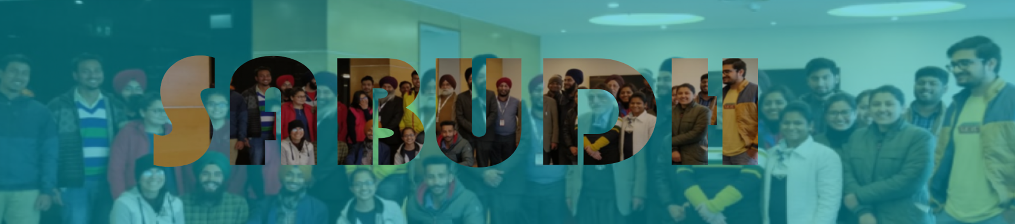
SABUDH FOUNDATION
AIOT BATCH -9 2025
PASSION PROJRCT FINAL PRESENTATION
RESCUE ROVER
PRESENTED BY:
NIHAL, NMAM INSTITUTE OF TECHNOLOGY, NITTE

Slide 2

TOPICS FOR
DISCUSSION
1
Introduction
2
Objectives
3
Sensors and modules used
4
System architecture
5
Results
6
Future scope
7
Conclusion

Slide 3
INTRODUCTION
Disaster-affected zones often present complex challenges for search and rescue teams, including limited visibility, hazardous terrain, and difficulty in locating survivors. In such scenarios, deploying autonomous or remotely controlled systems can significantly enhance the speed and safety of rescue operations.
This project presents a Rescue Rover, a smart, IoT-enabled robotic system equipped with ESP32-CAM for face detection using MediaPipe, real-time video streaming, and autonomous navigation.
By combining embedded systems, wireless communication, and AI-based vision, this rover aims to assist rescue personnel in identifying and reaching victims in disaster-struck areas more efficiently and safely.

Slide 4
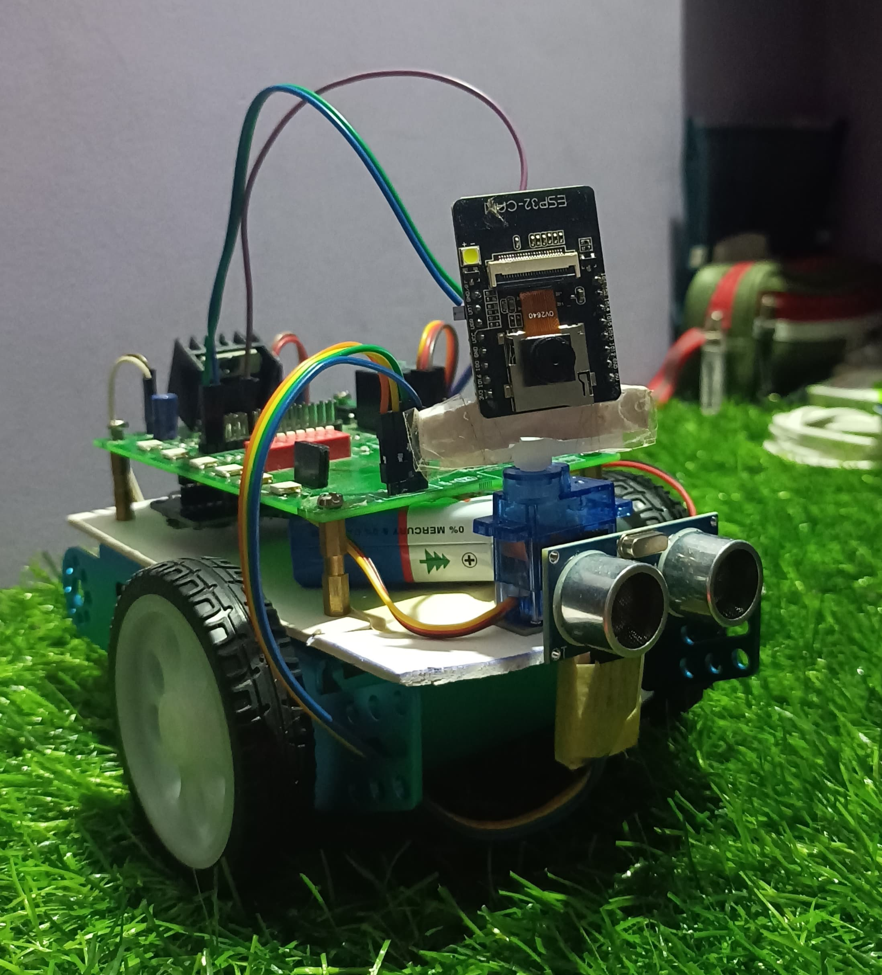
OBJECTIVES
To develop a rover capable of detecting and tracking human faces in disaster-hit areas using ESP32-CAM and MediaPipe.
To stream real-time video to a PC using Wi-Fi.
To automatically align the rover's direction using face detection.
To enable manual control of the rover via Flutter mobile app over Bluetooth.
To integrate environmental sensors (BMP280 and Ultrasonic) for safety and monitoring.

Slide 5
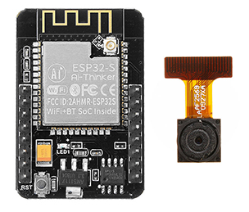
SENSORS AND MODULES USED
Component | Description
ESP32-CAM | Streams video and detects human faces using MediaPipe over Wi-Fi.
ESP32-DEV | Receives commands and controls motors and sensors via UART and Bluetooth.
Servo Motor | Rotates the camera across 180° for scanning the surroundings.
L298N Driver | Drives and controls the direction and speed of DC motors.
DC Motors | Enables forward, backward, and turning movement of the rover.
BMP280 | Senses atmospheric temperature and pressure values.
Ultrasonic Sensor | Measures front distance to avoid obstacles or collisions.
Flutter App | Provides manual control and displays real-time sensor data via Bluetooth.
MediaPipe | Performs real-time face detection and tracking from the video stream.

Slide 6
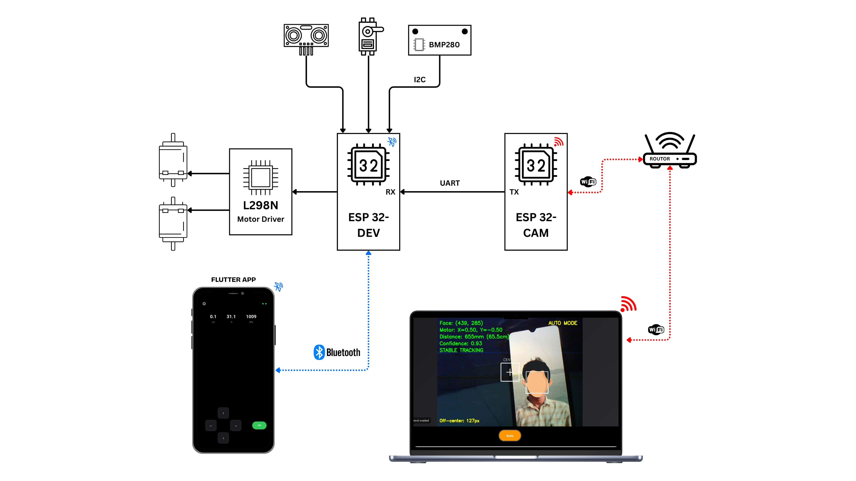
SYSTEM ARCHITECTURE

Slide 7
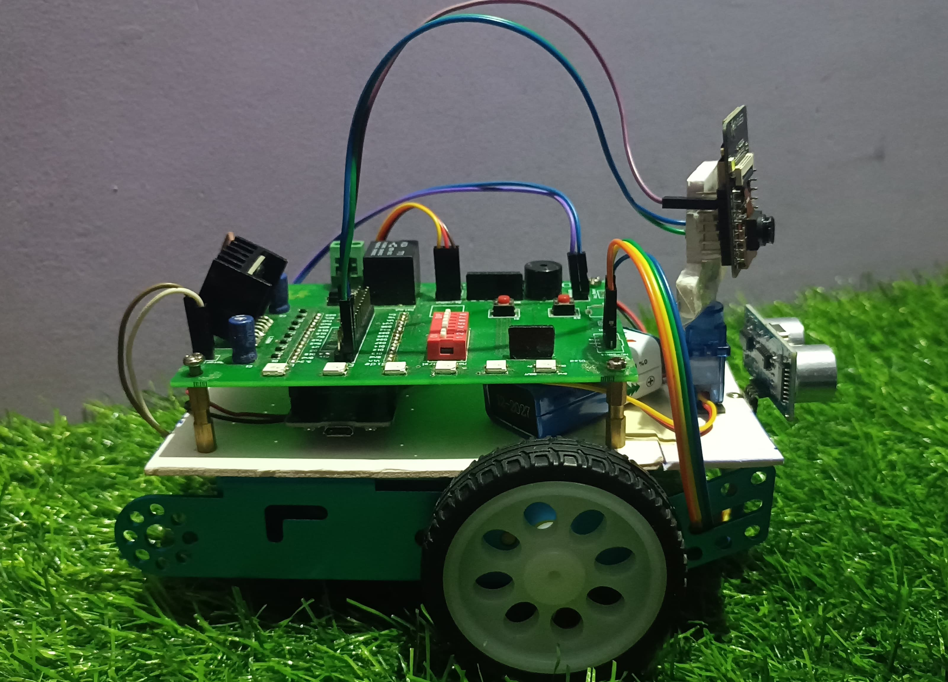
RESULTS - MODEL

Slide 8
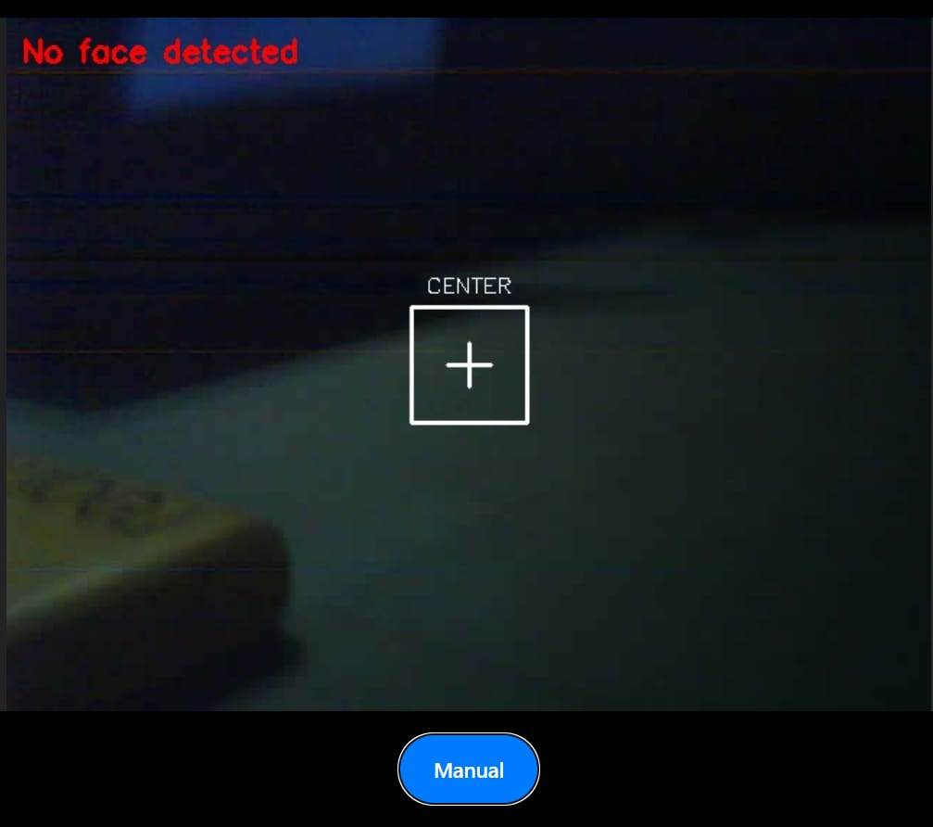
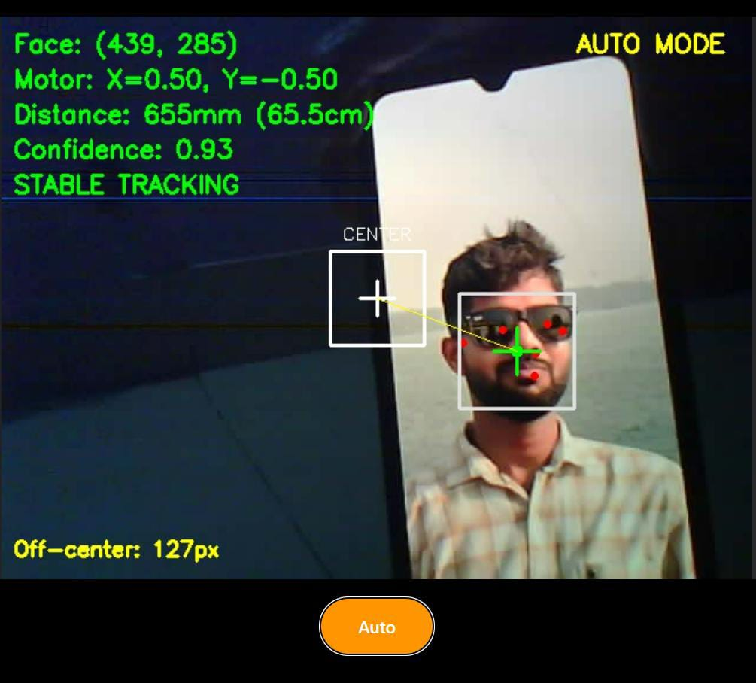
RESULTS – VIDEO STREAMING (PC)

Slide 9
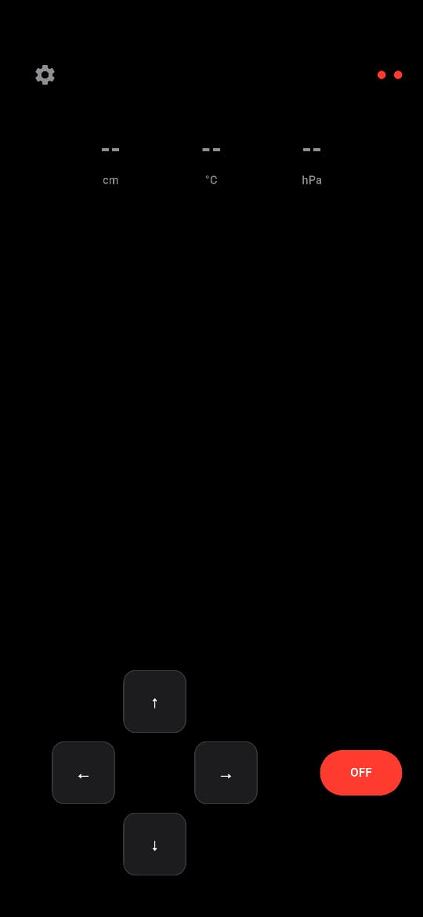
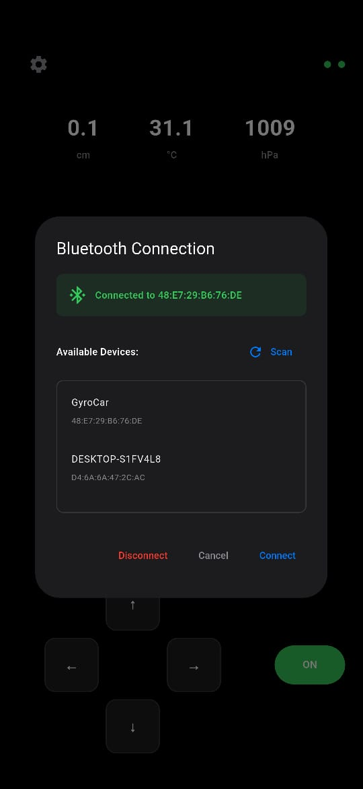
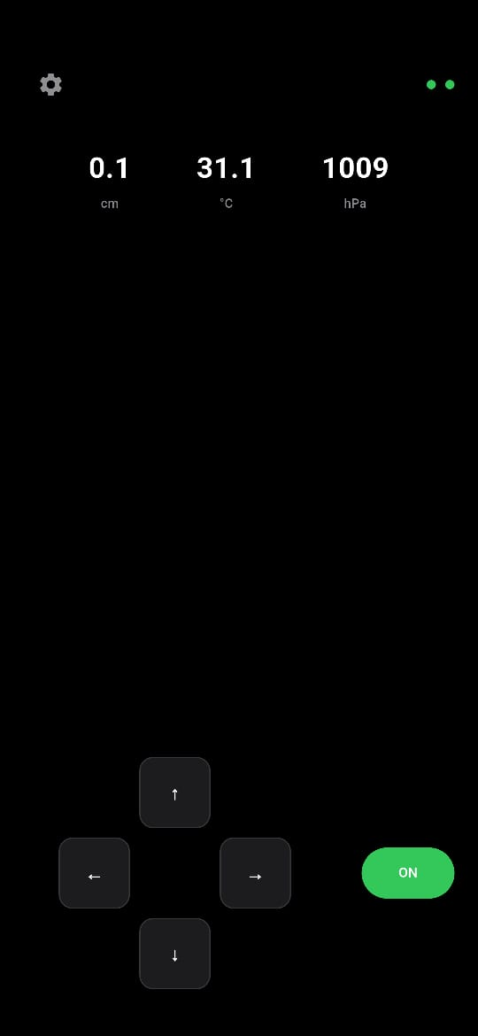
RESULTS – FLUTTER (MOBILE)

Slide 10
FUTURE SCOPE
Integrate GPS module for real-time location tracking.
Extend scanning range with pan-tilt camera mount.
Implement voice-based interaction or distress call detection.
Use of large power supply module to increase the work capacity and also integrating high intense light can be useful.
More compact model where it can reach small space.

Slide 11

CONCLUSION
The project successfully demonstrates the potential of IoT, AI (MediaPipe), and mobile integration in disaster response.
Offers dual control (manual + auto), real-time tracking, and obstacle avoidance.
Provides a solid base for further development into real-world rescue solutions.

Slide 12
THANK YOU

